Slide 1
AIHOPS

Slide 2
Main Features
User Management - Gmail
Survey Creation
Survey Publish
Members invitations
Result Analysis
Admin Capabilities

Slide 3

React
Cookie management
Sign in with Gmail
Graph design
Upload to Production

Slide 4

changing Requirements
Factor Creation fields
Project Publication conditions
Admin Capabilities
Dark Theme

Slide 5
No Sql db
Picture upload

Slide 6
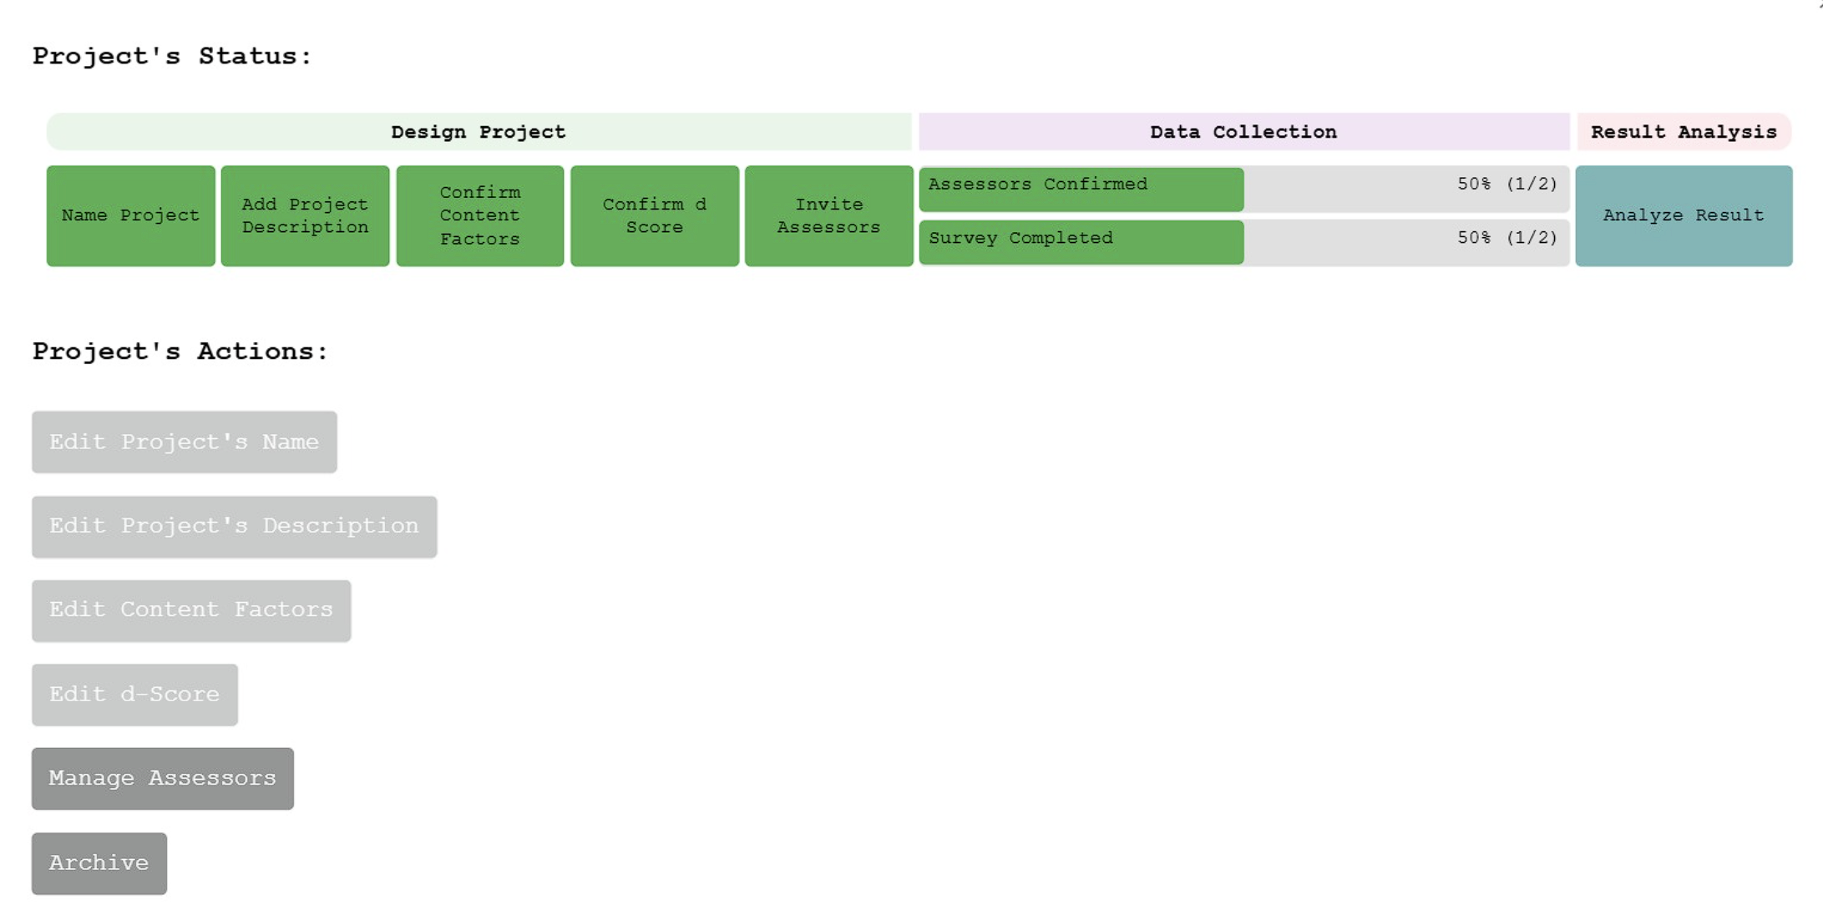
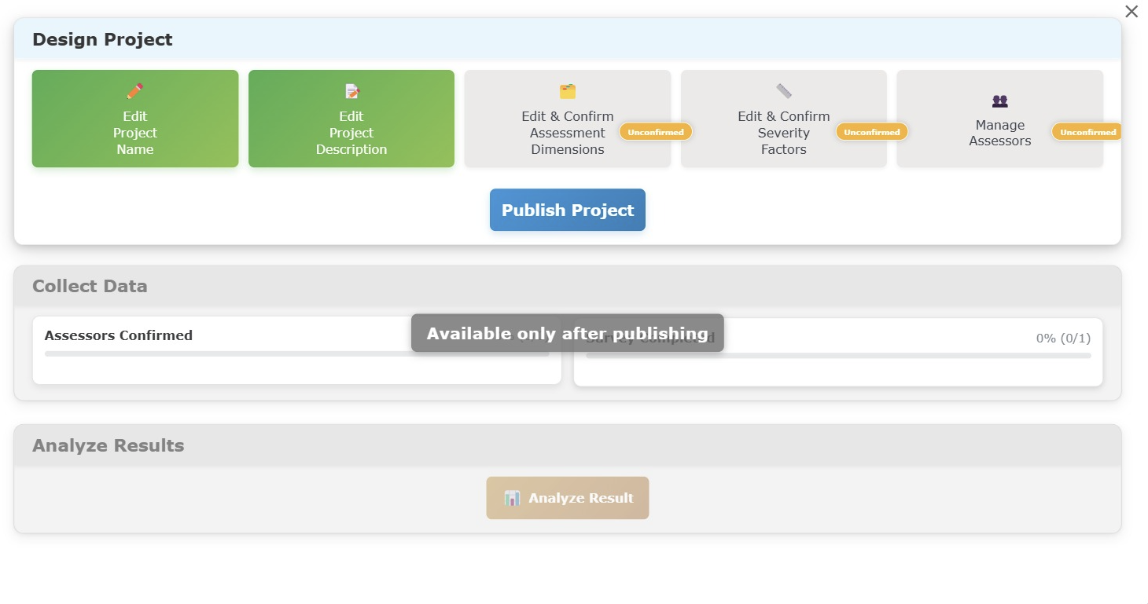
Massive design changes

Slide 7
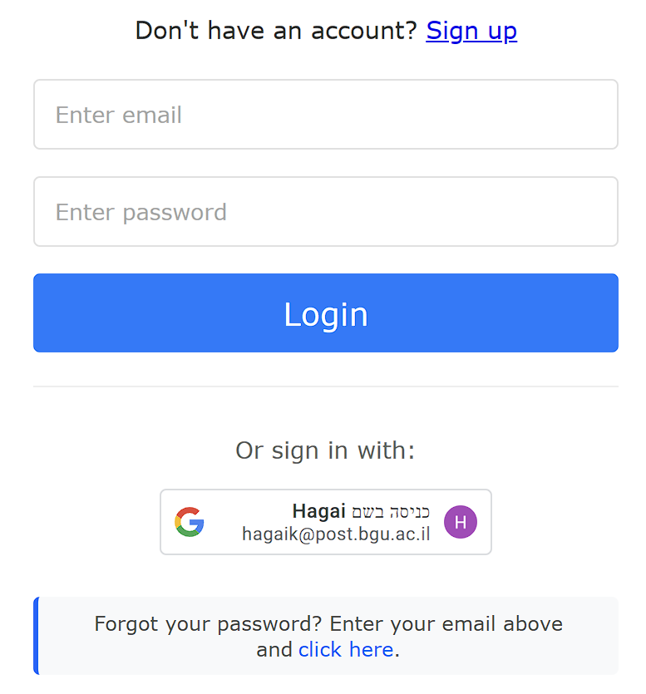
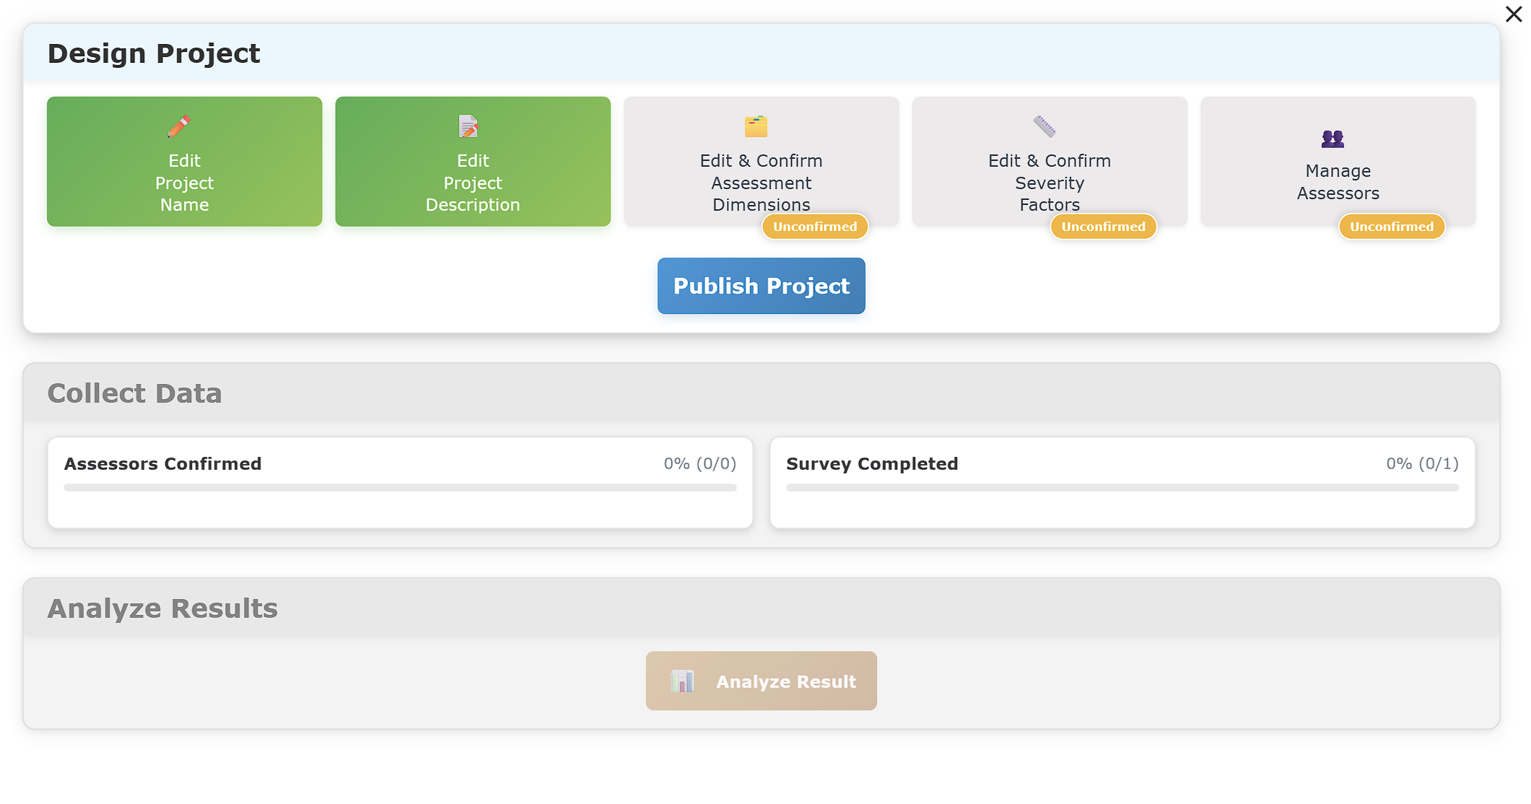
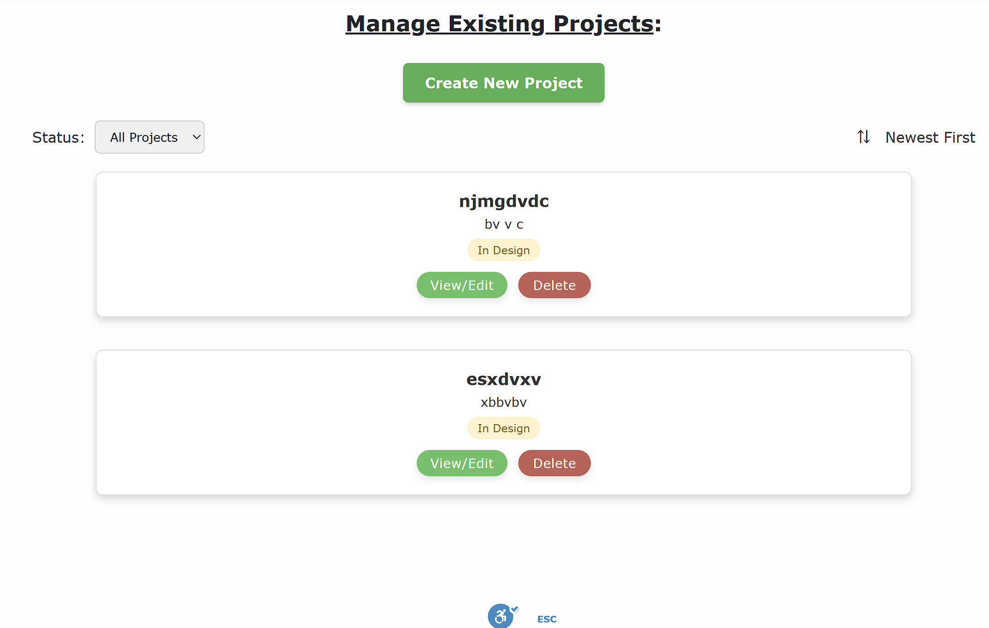
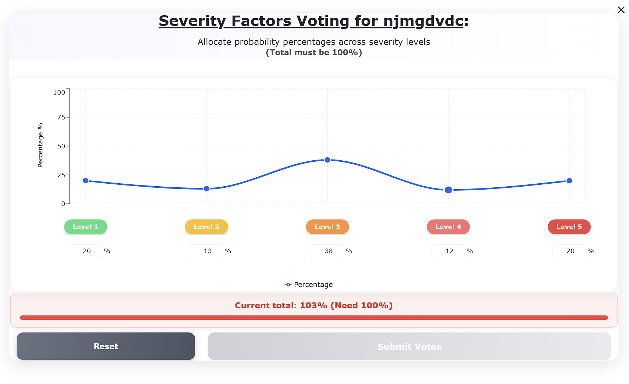
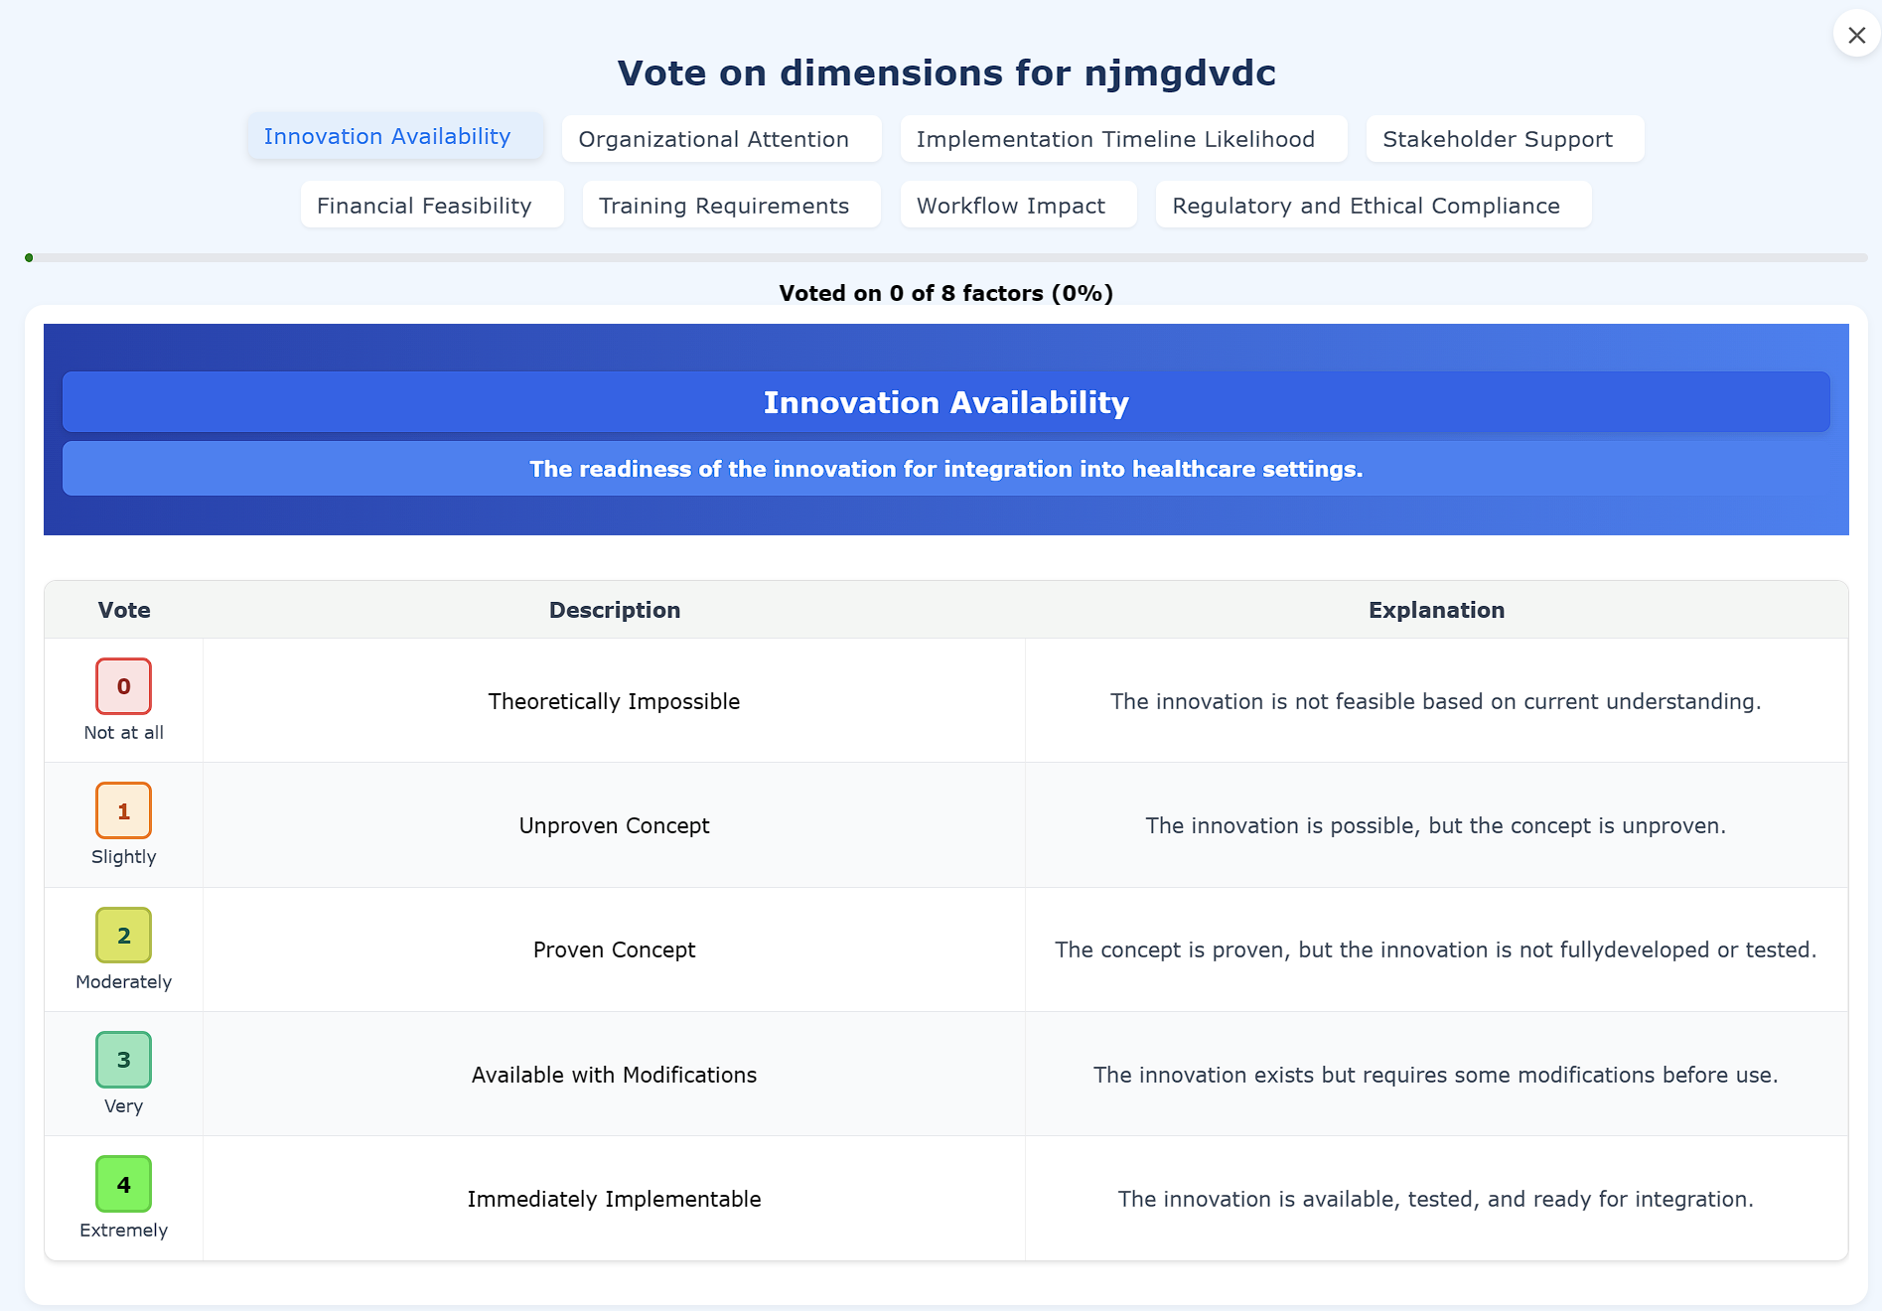
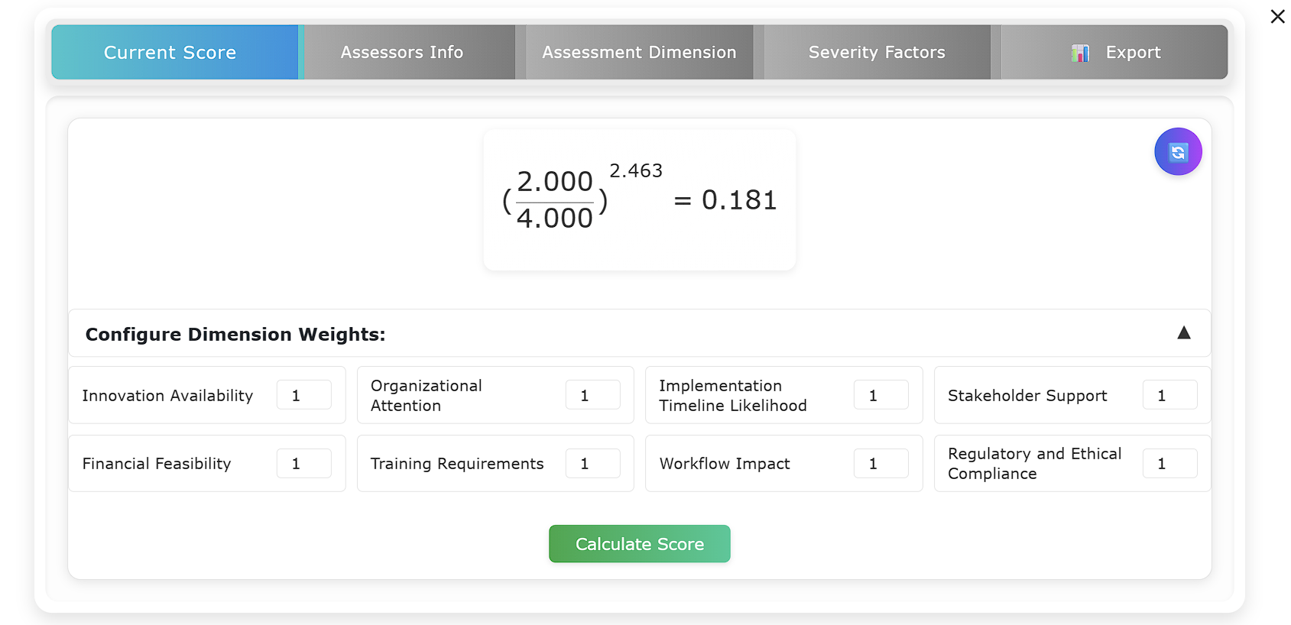
Final Result
A functional website, fulfilling all the requirements.

Slide 8
THANK YOU
AIHOPS Team

